Slide 1
Experimentally Informed Site-Specific Substitution Models Substantially Deepen Divergence Estimates
Notes:
Color scheme
black = "black”
blue = "#439FC3”
green = "#397262”
orange = "#F9842A”
red = "#B52A24”
pink = "#CC79A7"

Slide 2
Notes
The raw figures come from `figures.ipynb` in this directory.
If you don’t change the size of the output figure you should be able to plop them into this presentation to produce the final figures.

Slide 3
MAIN FIGURES

Slide 4
Model feature comparison

Slide 5
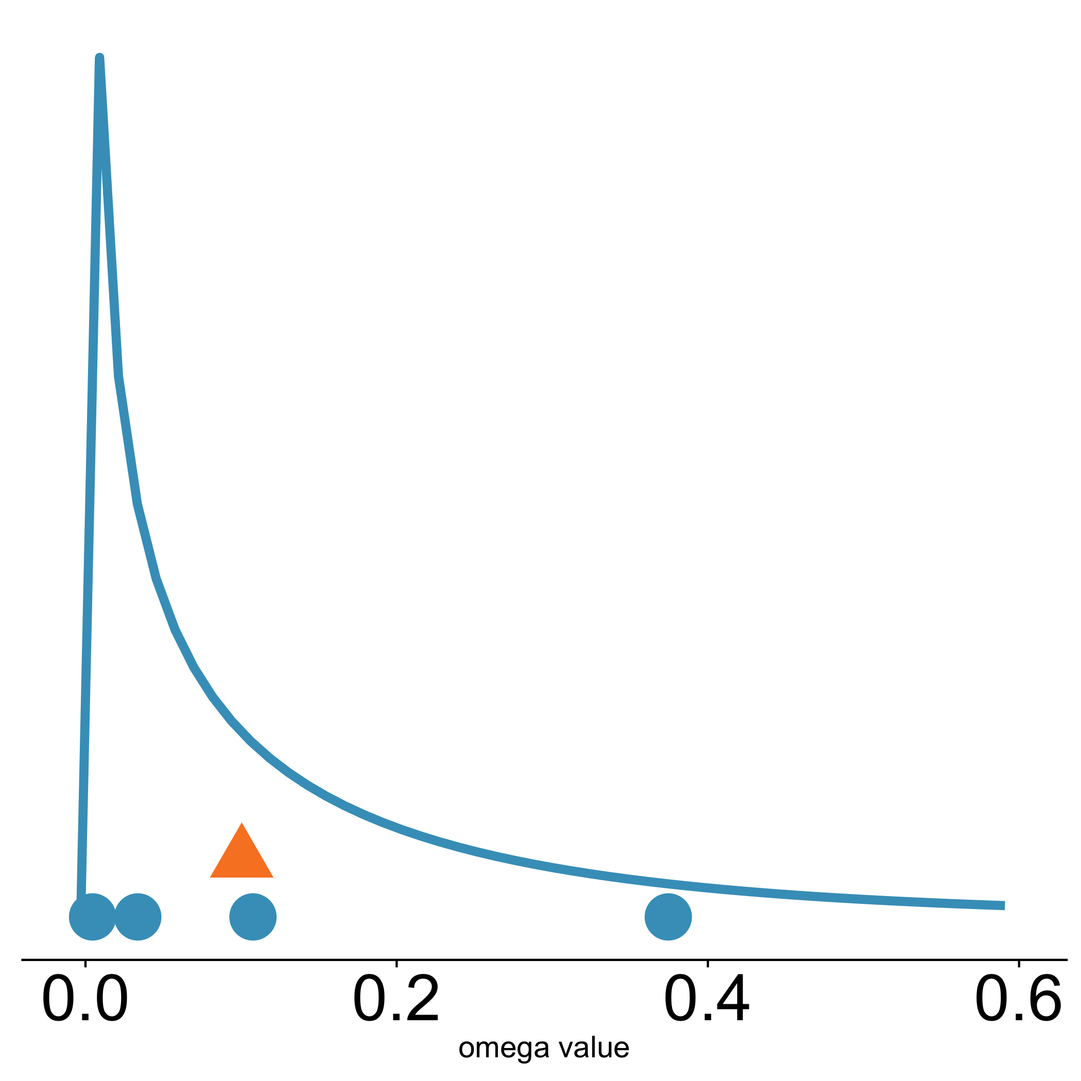
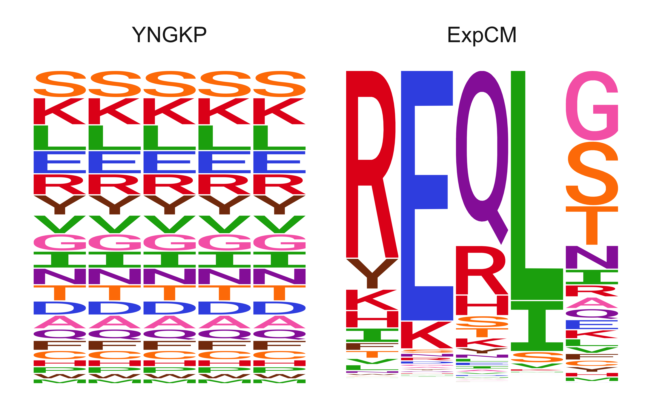

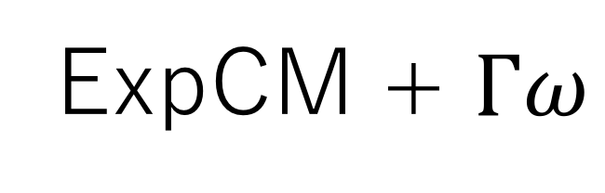

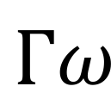


A
B
C
Uniform stationary state
Site-specific stationary state
Site-specific stationary state
$Γω$ rate variation
$ω$ value
$$Γω$$
GY94
single value
GY94 + $Γω$
ExpCM
ExpCM + $Γω$
$ω$ value

Slide 6
Decay to stationary state

Slide 7
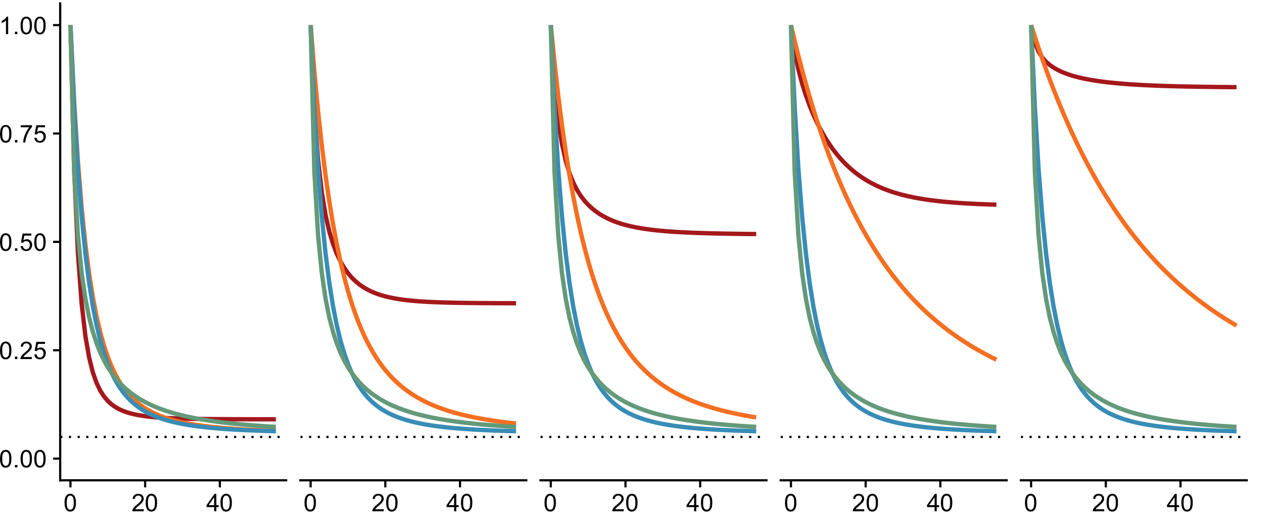
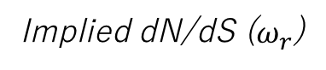
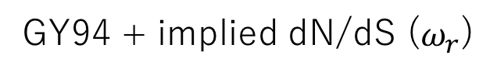
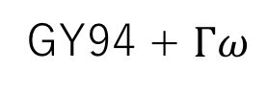
209
17
28
193
316
Site in HA
0.91
0.46
0.36
0.14
0.10
Implied dN/dS ($ω_{r}$)
Model
Expected pairwise amino-acid identity
ExpCM
GY94
GY94 + $Γω$
GY94 + implied dN/dS ($ω_{r}$)
Branch length (codon substitutions per site)

Slide 8
Simulations

Slide 9
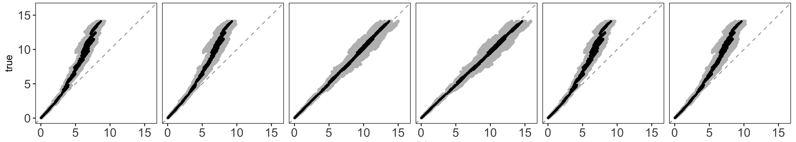
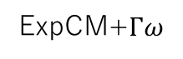
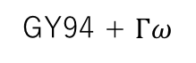
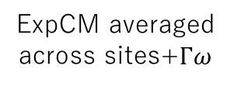
Actual branch length
GY94
GY94 + $Γω$
ExpCM
ExpCM+$Γω$
ExpCM averaged across sites
ExpCM averaged across sites+$Γω$
Branch length optimized by the model

Slide 10
Model Comparison Trees

Slide 11
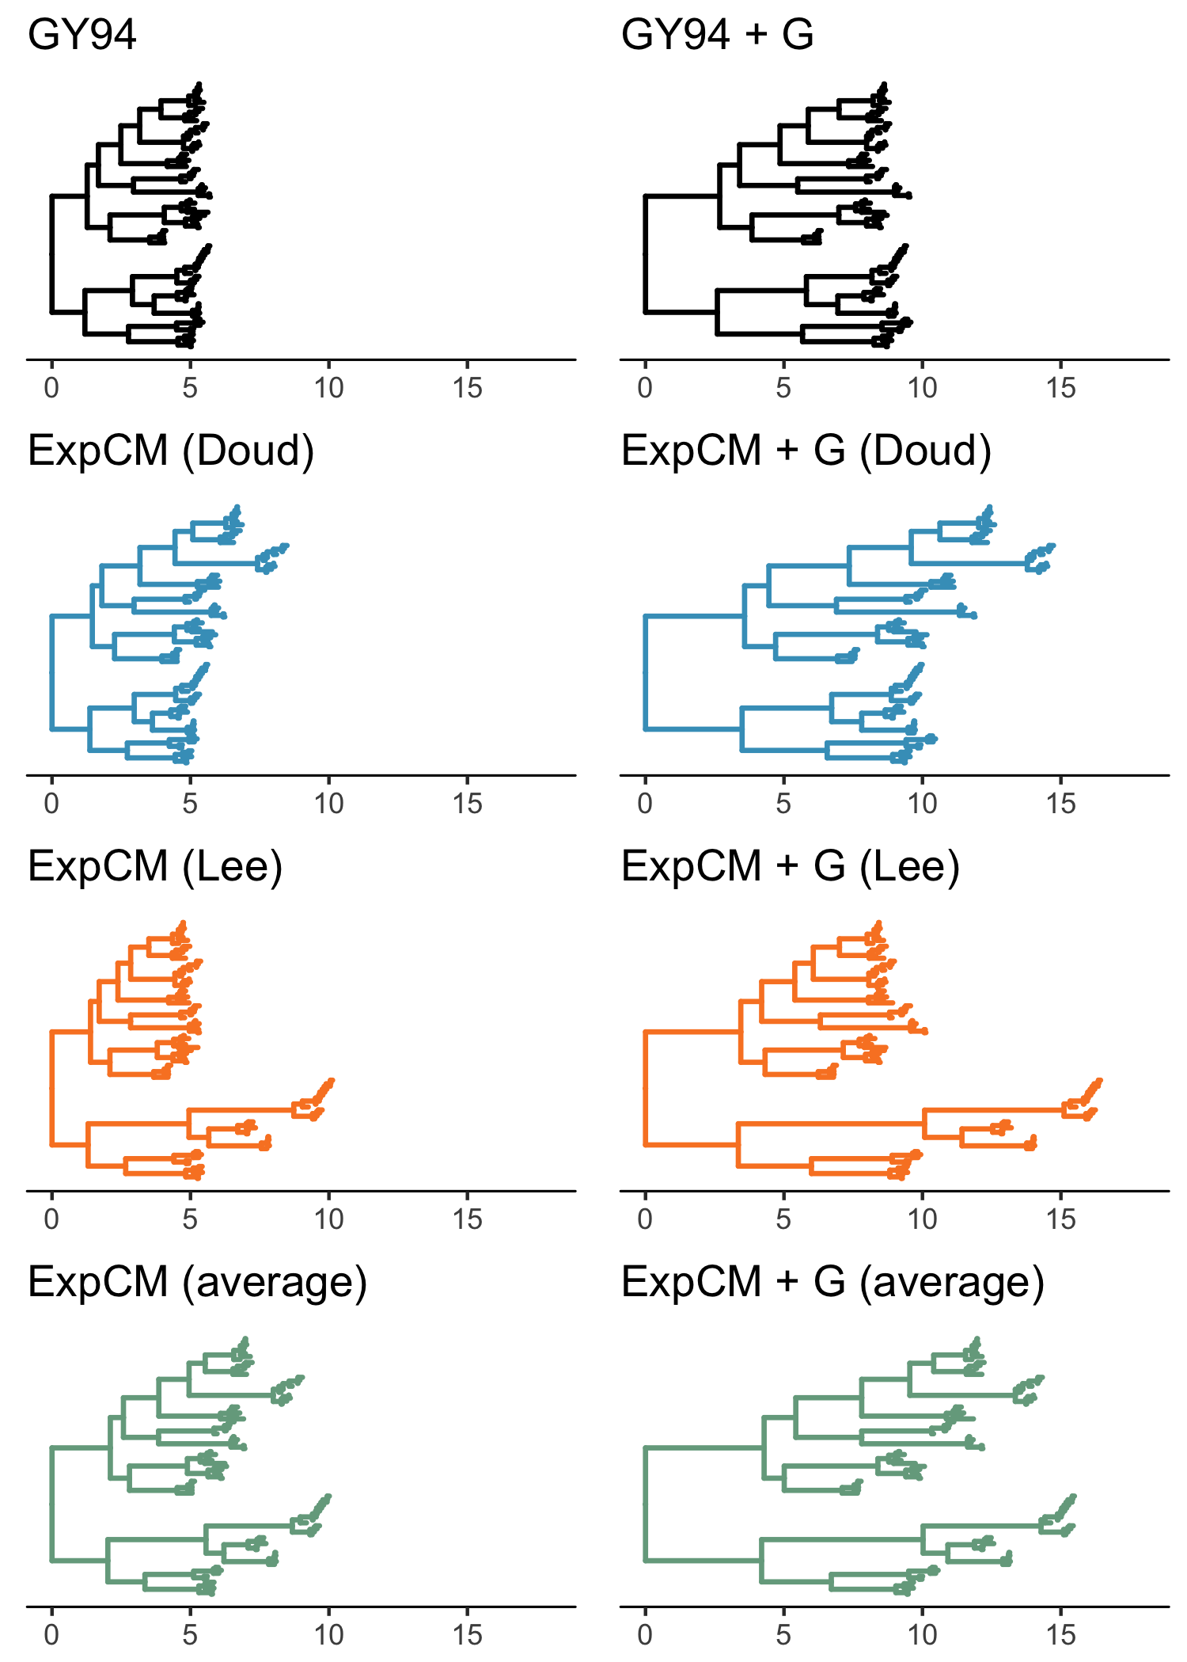
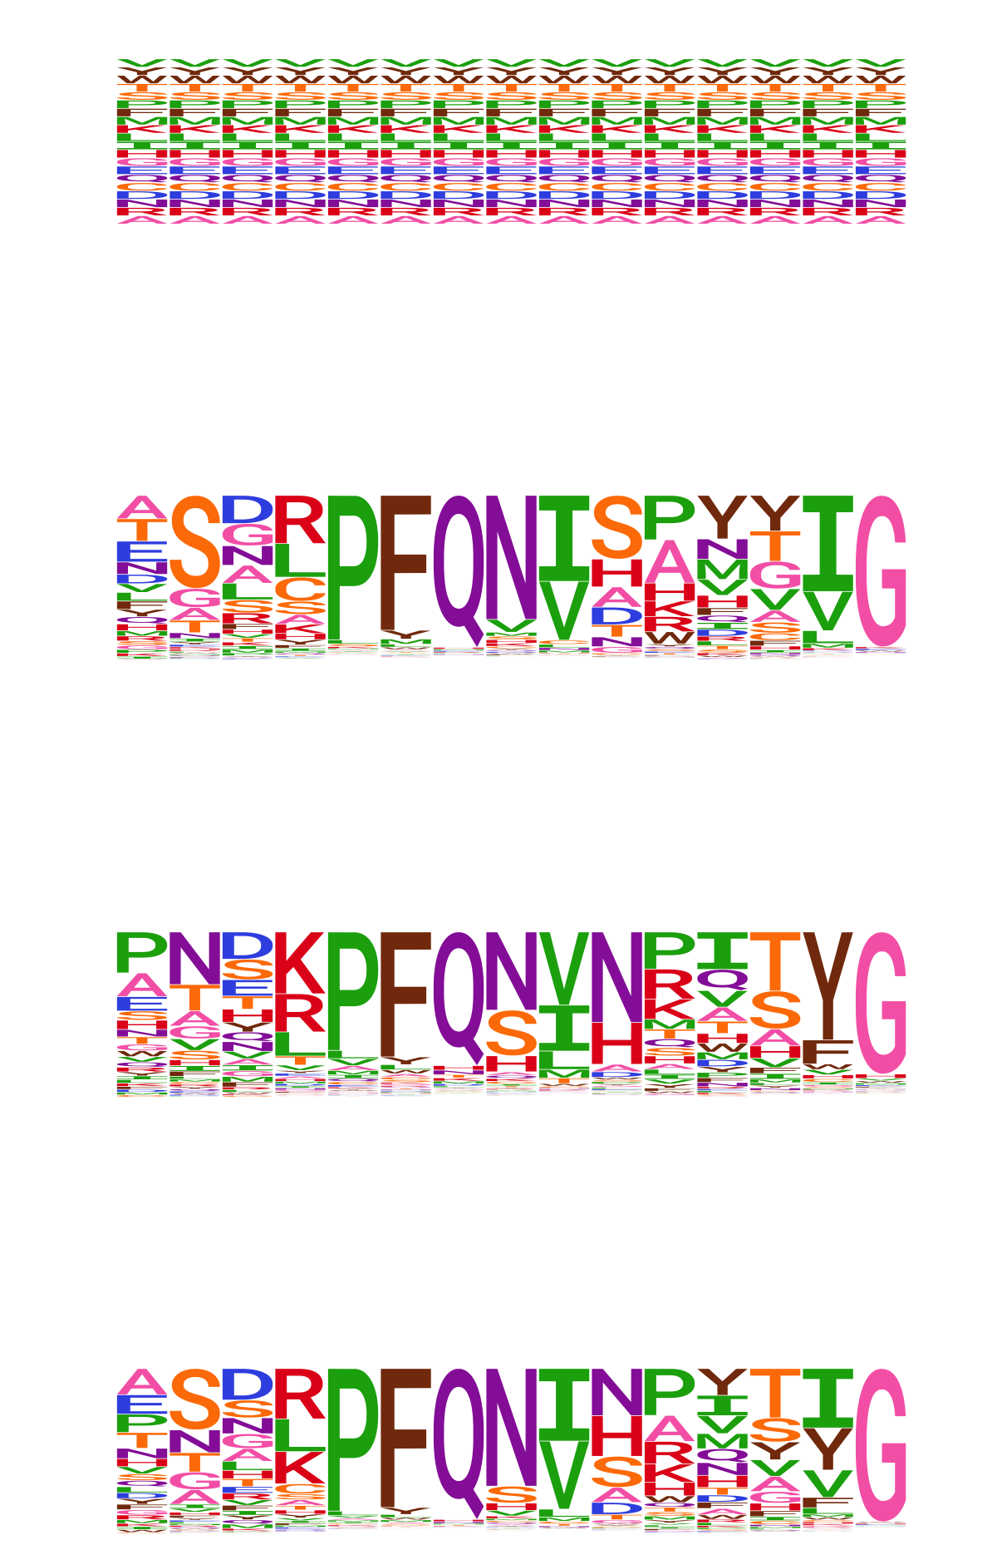

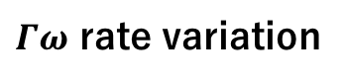
No rate variation
$Γω$ rate variation
GY94
ExpCM + $Γω$
ExpCM (H1)
ExpCM (H3)
ExpCM (H1+H3 avg)

Slide 12
Competing effects

Slide 13
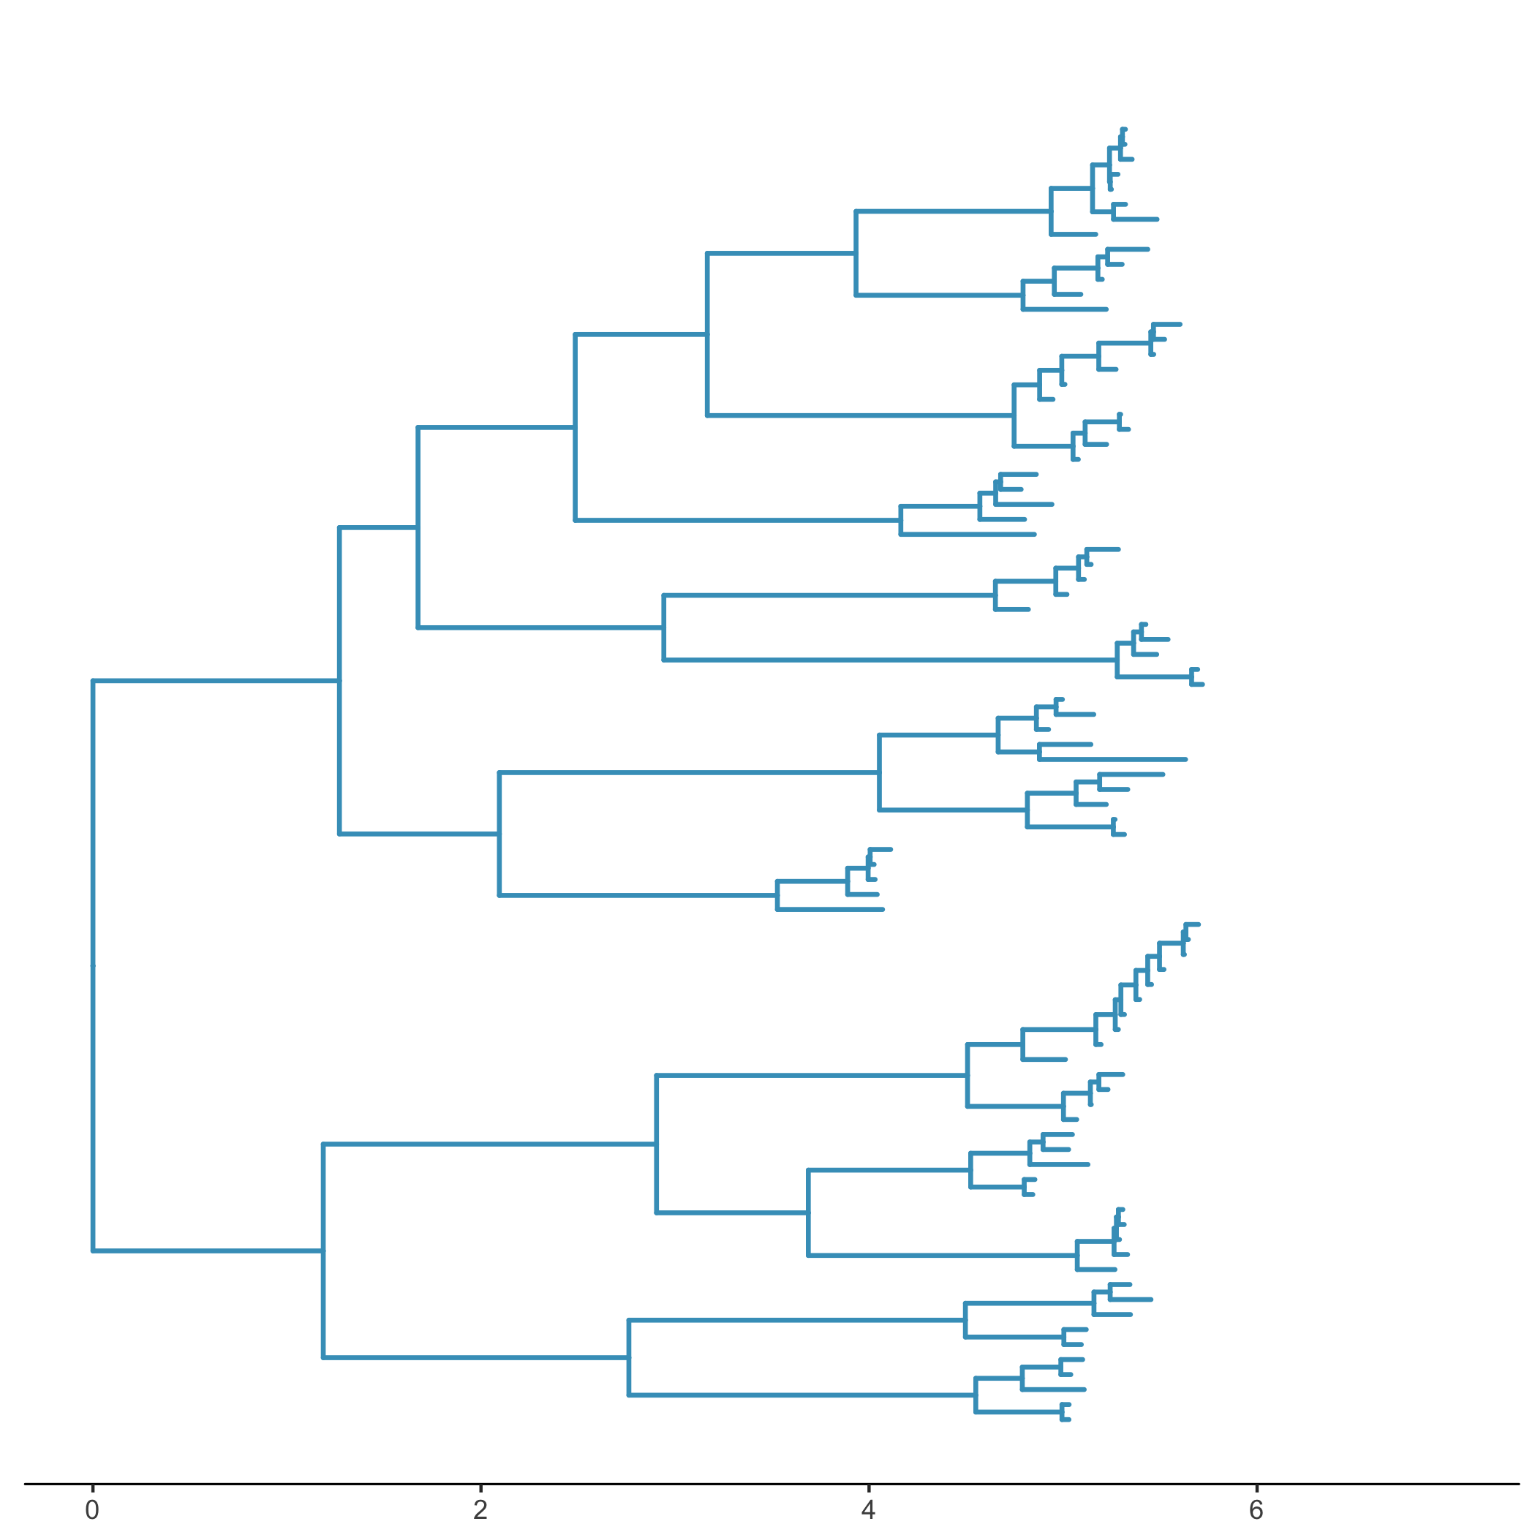

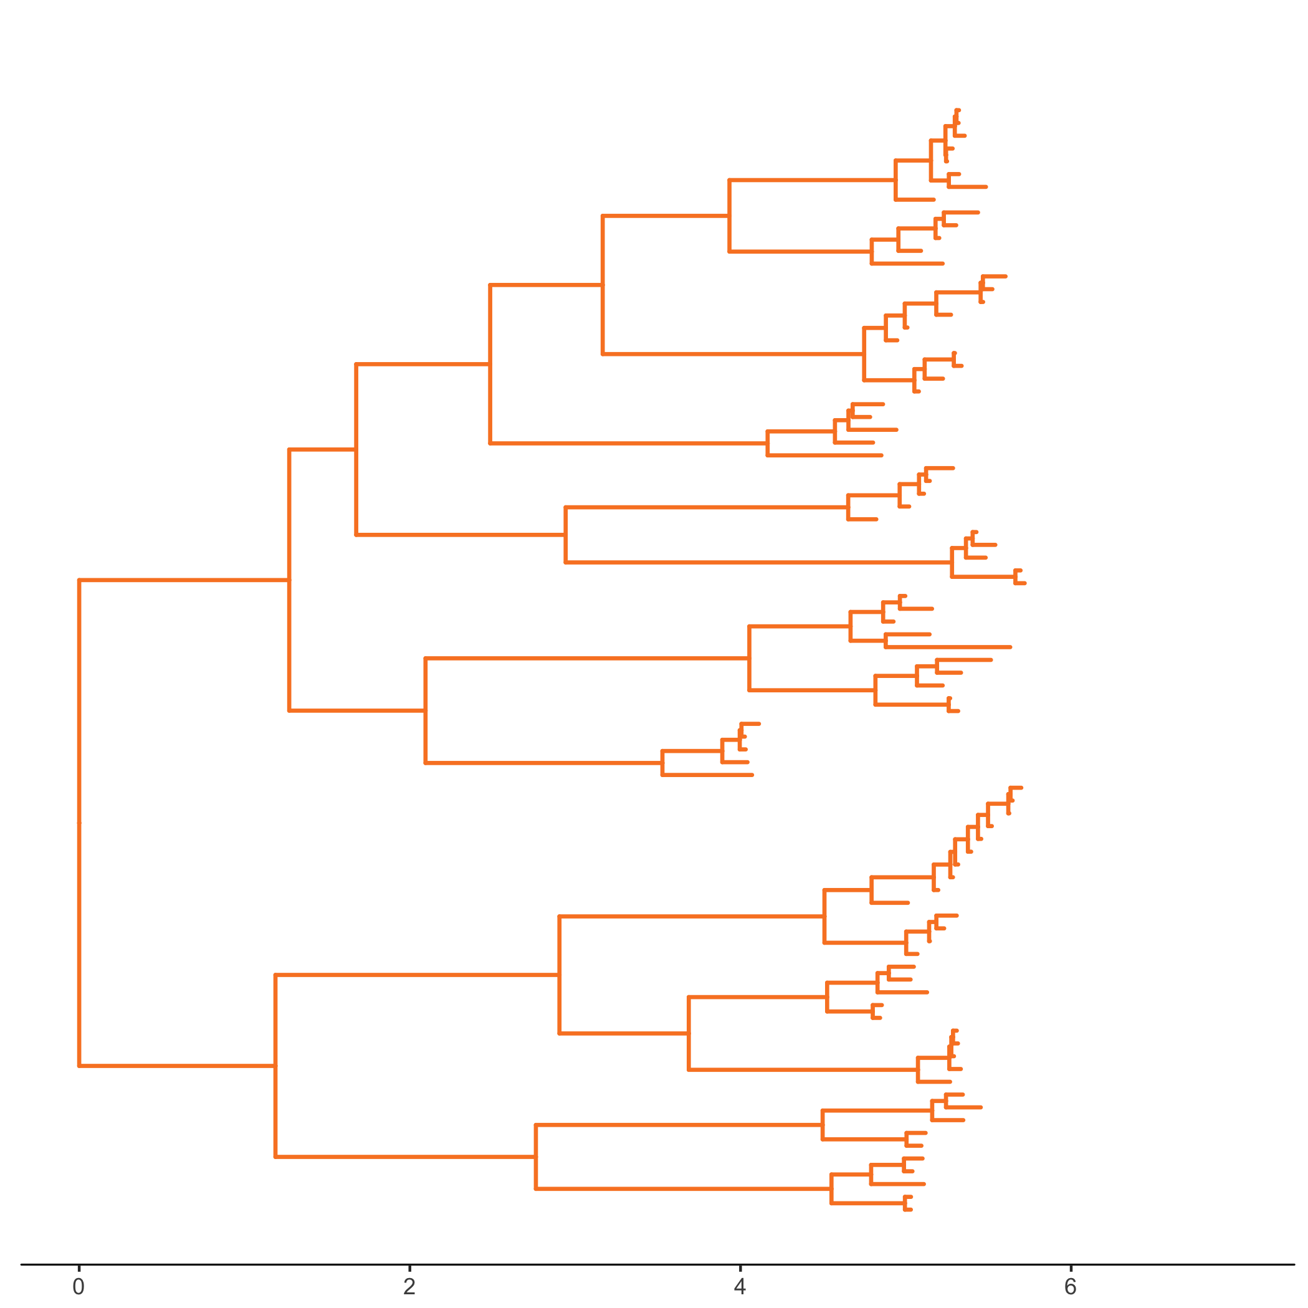
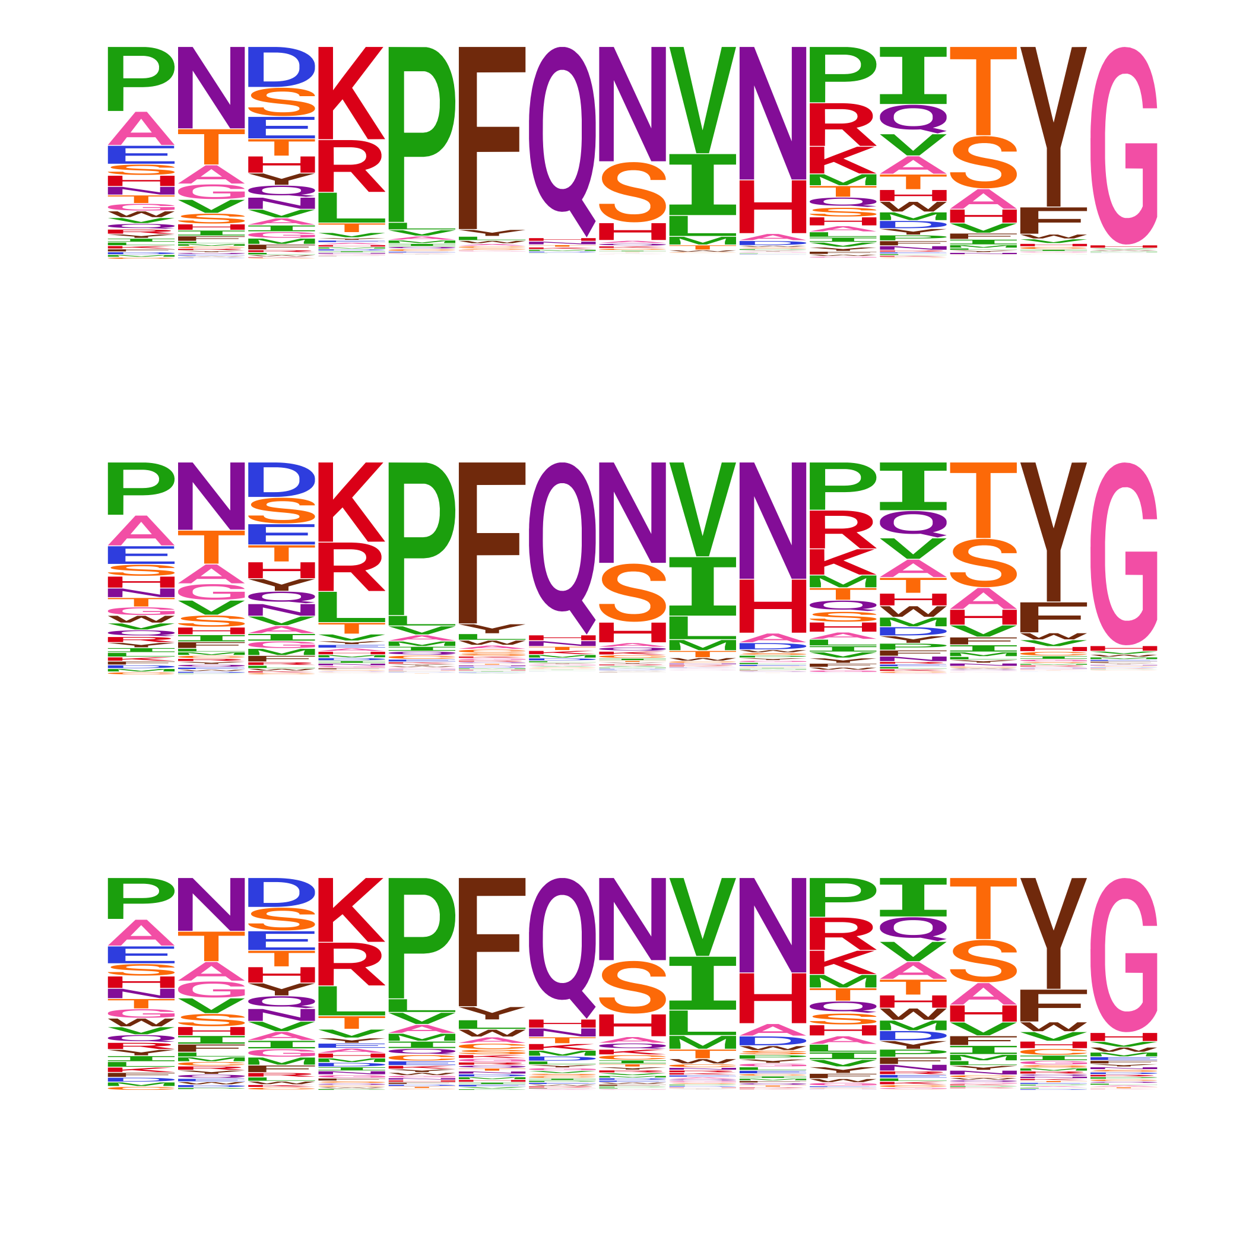
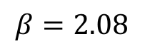
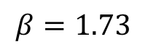
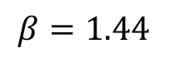
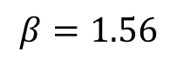
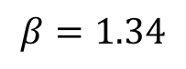
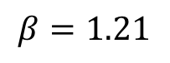
ExpCM(H1 prefs)
low
$$β=1.56$$
low
intermediate
$$β=1.34$$
high
intermediate
$$β=1.21$$
high
ExpCM(H3 prefs)
high
intermediate
low
$$β=2.08$$
intermediate
low
$$β=1.73$$
high
$$β=1.44$$

Slide 14
`phylobayes`

Slide 15
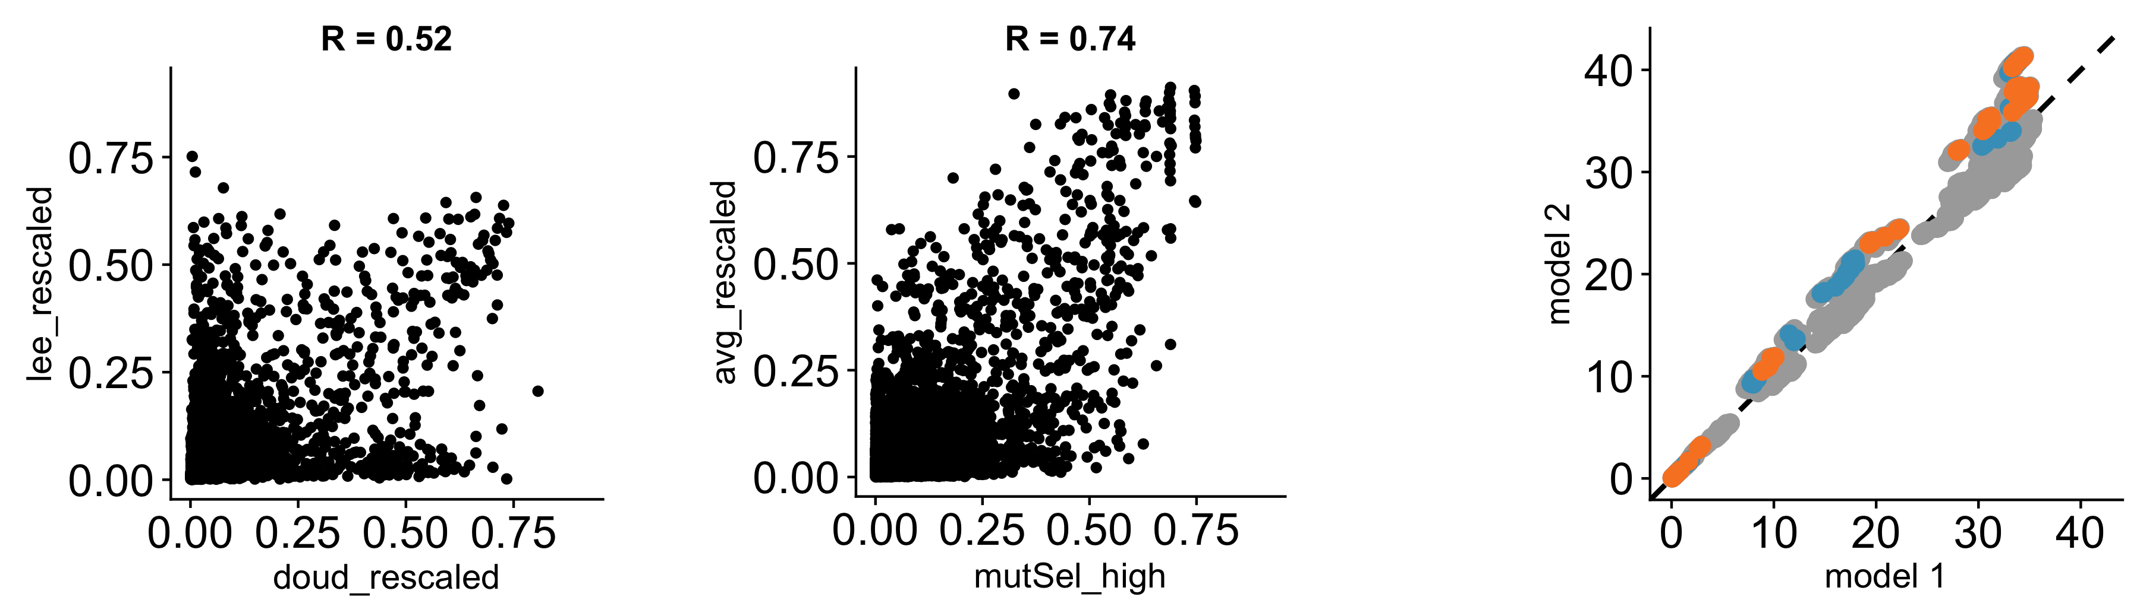

A
B
r = 0.52
r = 0.74
Branch from
H1
ExpCM+$Γω$ (H1+H3 avg) normalized branch length
H3
H3 prefs
H1+H3 avg prefs
H1 prefs
mutSel prefs
mutSel normalized branch length

